Slide 1

FOOTBALL COLOSSEUM TO PLACEHOLDER
By -
GROUP 1 : TATTWA SHIWANI, ASHMIT BATHLA, PIYUSH KUMAR, PATIL VED VINAY

Slide 2

ABOUT DATA
This dataset includes comprehensive statistics for each player from the past five seasons across the top five European football leagues: LaLiga, Ligue 1, Bundesliga, Premier League, and Serie A. Key metrics include player statistics, final standings, market value trends, positional market value by 2024, and market value by nationality. Additional data points include comparisons of individual player performance and aggregated club statistics, offering valuable insights into team and player dynamics over multiple seasons
USE CASES
Player Performance Analysis: Compare player statistics across multiple seasons, with three-player comparisons for enhanced insights.
Market Value Insights: Examine market value trends over time, assess market value by position and nationality, and understand valuation patterns for 2024.
Team and League Analysis: Analyze club and league performance, identify key trends, and explore strengths and weaknesses using scatterplots, radar charts, and other visualizations.
Scouting and Recruitment: Use historical performance and market value data to identify potential recruits and assess value relative to performance

Slide 3
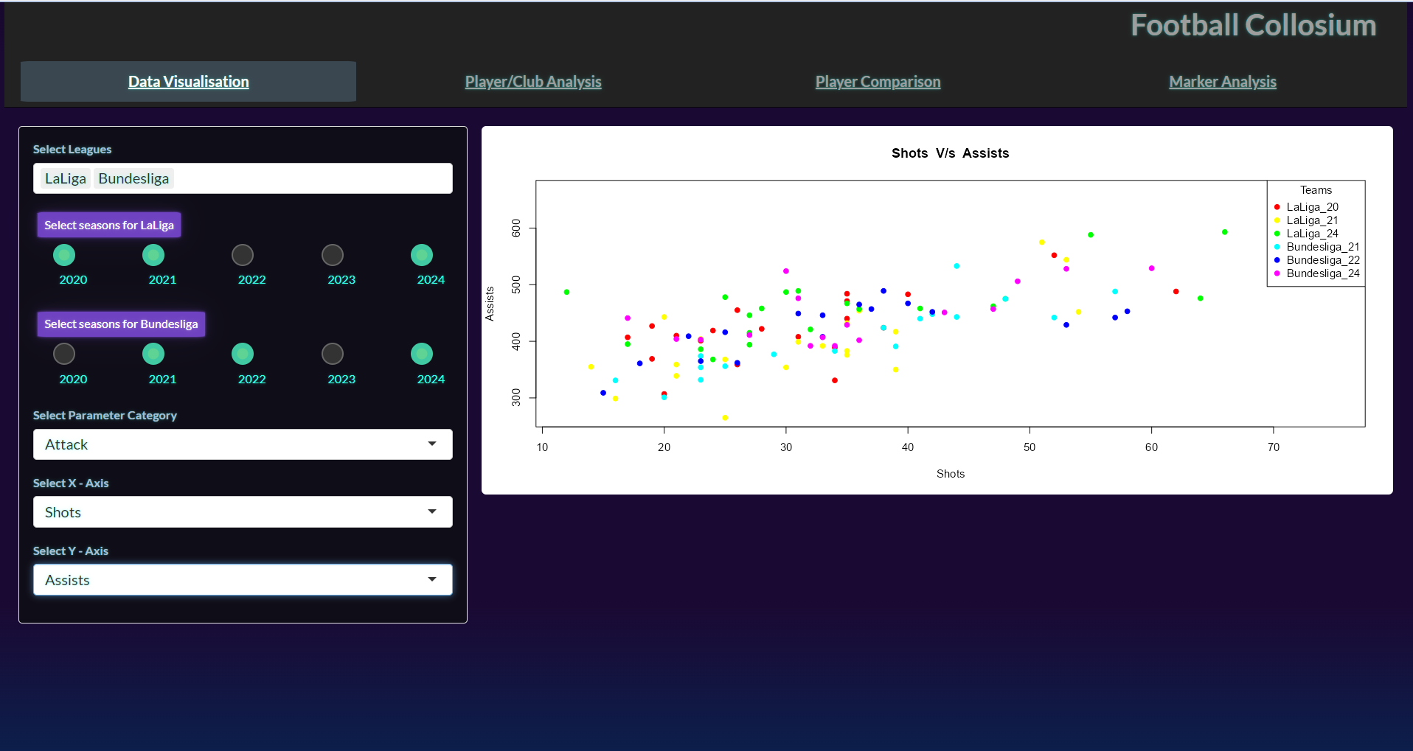

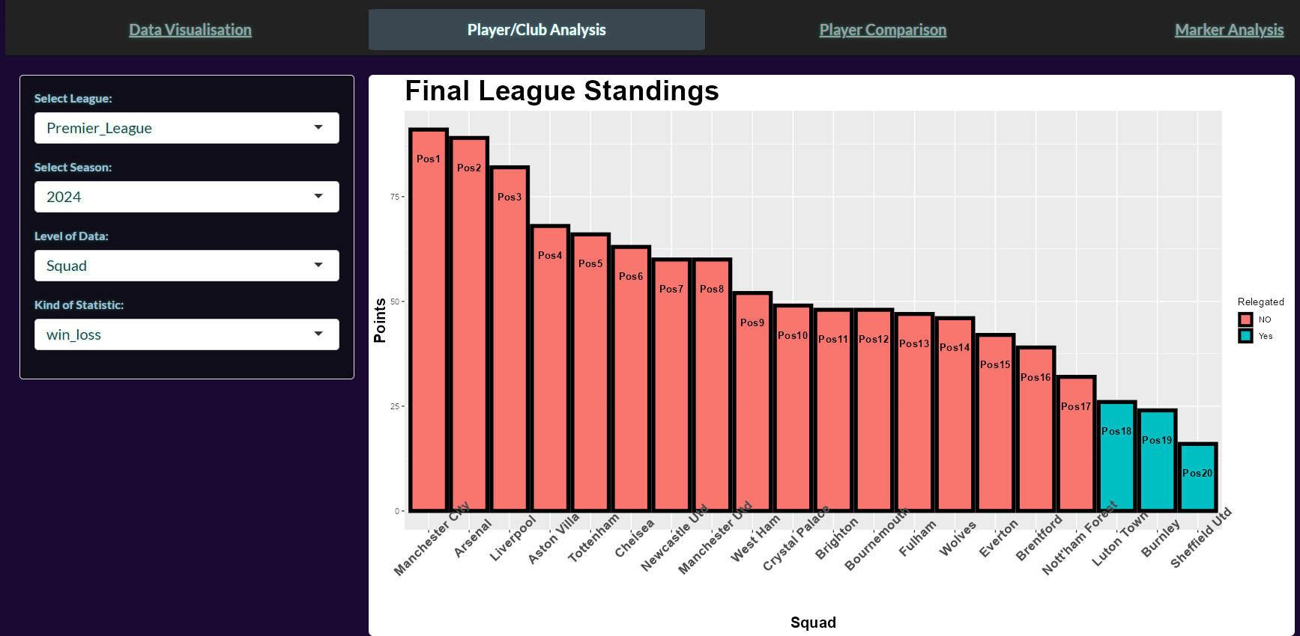
DATA VISUALISATION
A scatterplot visualizes statistics from the past five league seasons, allowing for clearer visual interpretation of trends and patterns
CLUB ANALYSIS
The final standings and complete statistics for all teams across all seasons are displayed

Slide 4
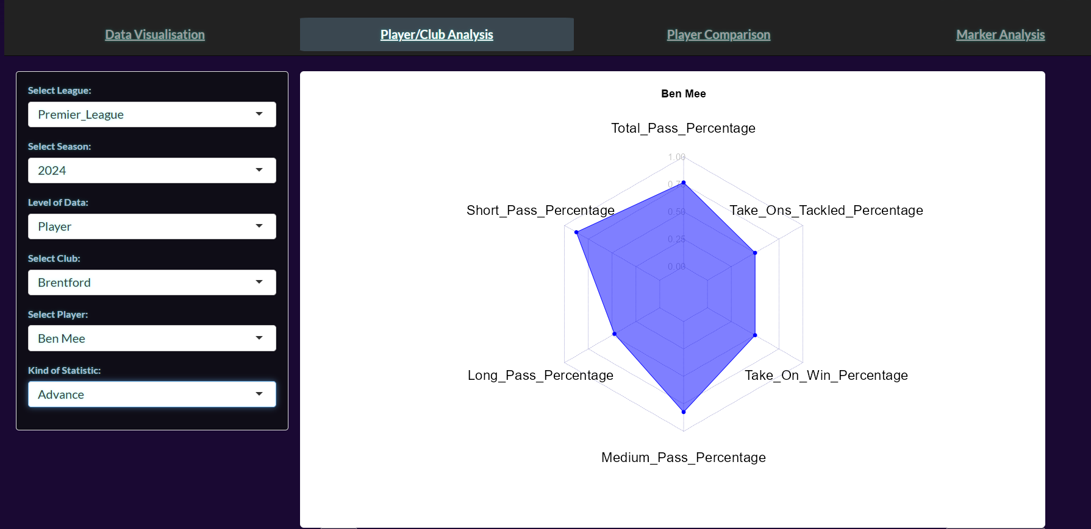
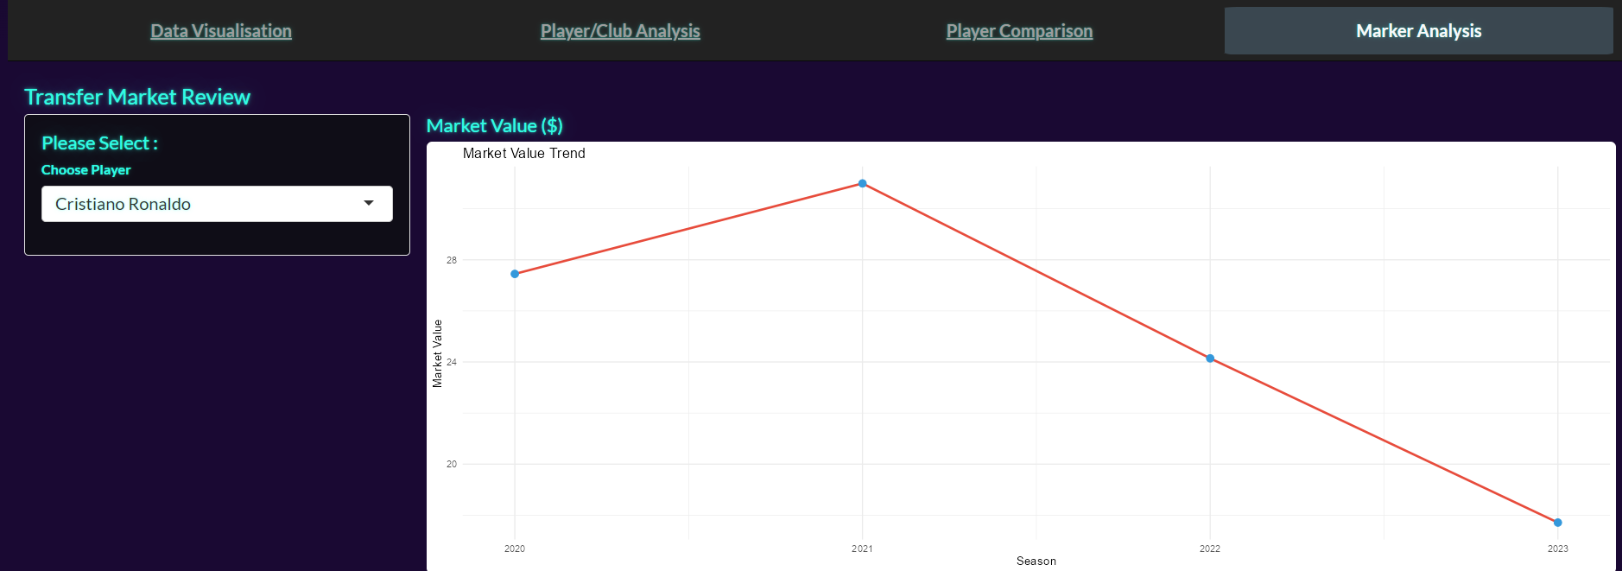
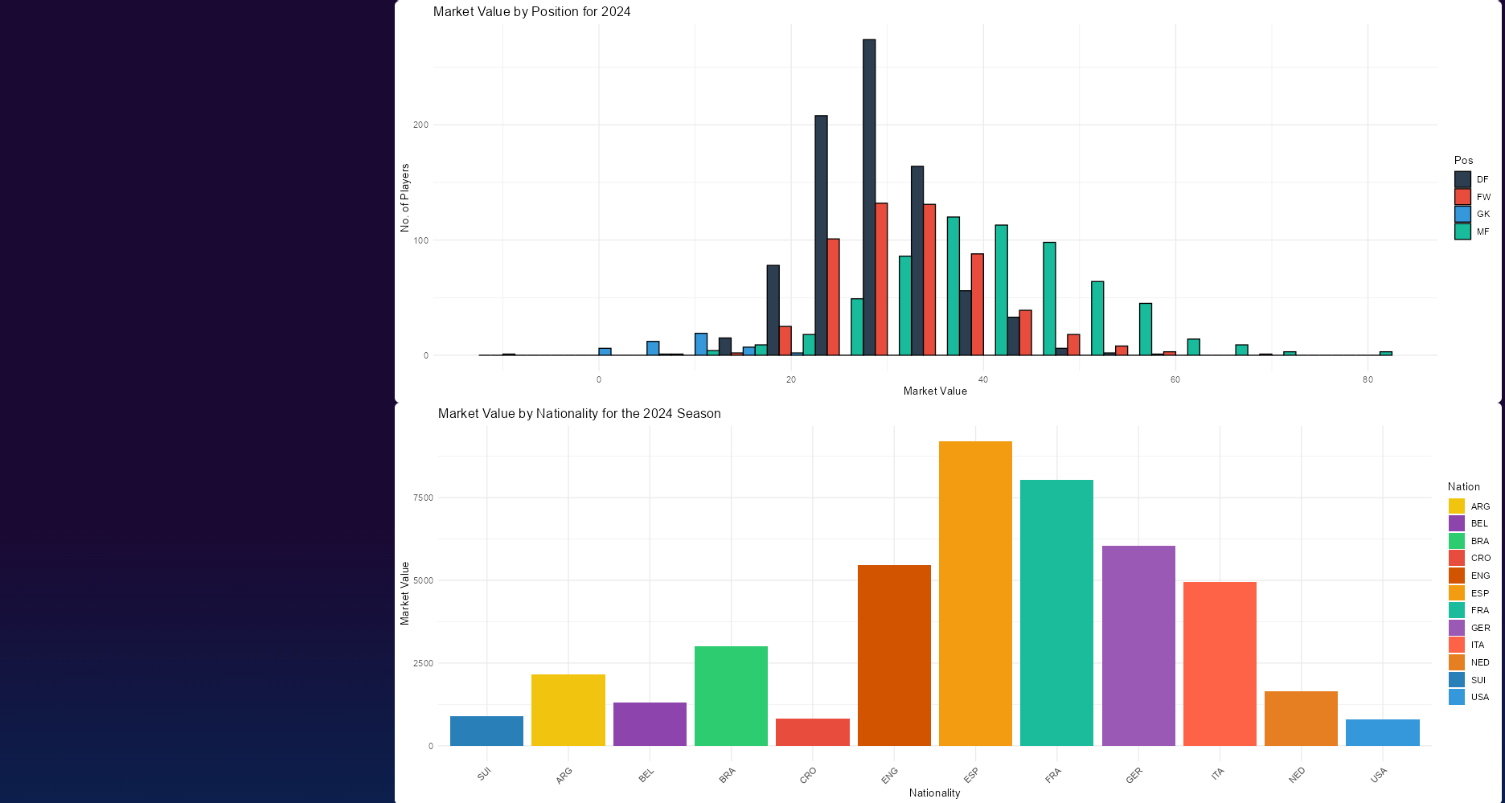
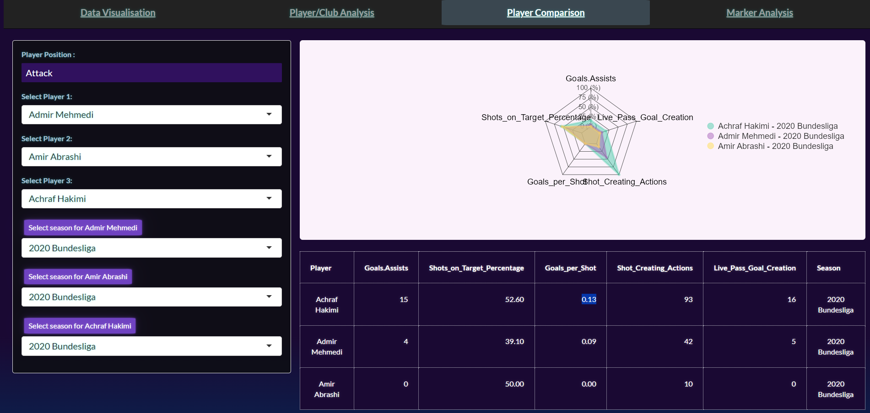
PLAYER ANALYSIS
MARKET ANALYSIS
Statistics for each player from every club, including goalkeepers, are displayed
For each player, the market value trend, position-specific market value as of 2024, and market value by nationality for the 2024 season are displayed
PLAYER COMPARISON
A clear, easy-to-understand comparison of player statistics is provided, featuring three players at a time

Slide 5
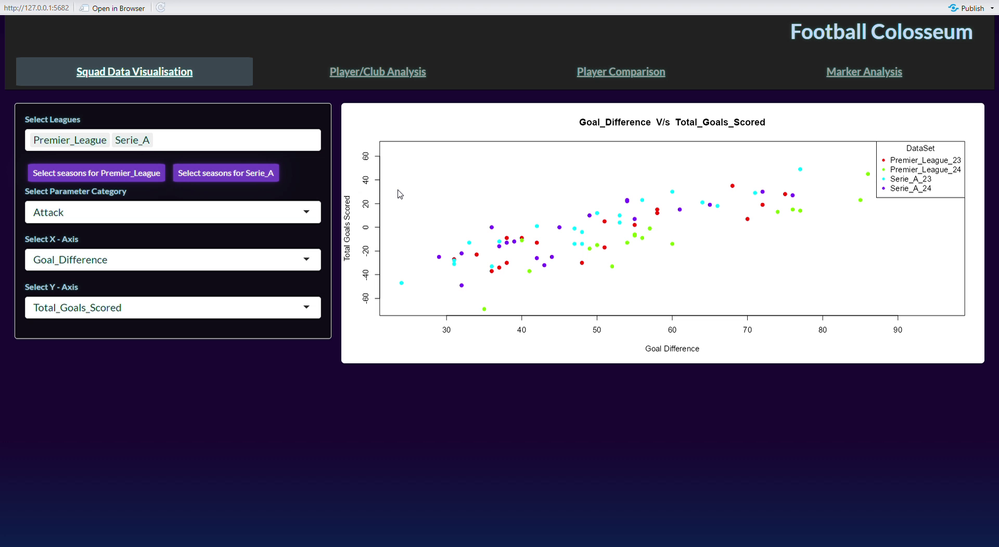
Demonstration of ShinyApp Running

Slide 6

LOGO
THANK YOU

